Slide 1

J. Al-Bahar Trad & Cont. Co .
P.O. Box 26480, Safat Code 13125, State of Kuwait

Slide 2
1
Our Vision, Mission and Goal
2
Our Journey
3
Our Services
4
Project Delivery Methodology
5
Company Future
Our Facilities
6
Our Reference Client’s

Slide 3

1
Our Vision, Mission and Goal
To become the leading Contracting, Consultancy, and Facility Service Provider in Kuwait
Adapt latest technologies to improve the work quality with cost effectiveness
Offer A One Stop Shop - cost effective modern construction, and consultancy solution

Slide 4

2
OUR JOURNEY
2023 - 2026
Projects – Waste Management
2021 - 2022
O&M for Animal Waste Plant
2020
EPCC for Animal Waste Plant
2019
GCC Projects
2018
New
2017
Turnkey Projects
2015
2014
Fabrication Facility
Construction Subcontracts
2012
Maintenance Tenders
2009
Facility Maintenance - AMC
History
Building Material Trading
2003

Slide 5

3
Our Services
PROJECTS
CONSULTANCY
DIVISION
Project Financing
Principal Consultant
Project Engineering
Project Management
Educational Services & Training
FACILITY
DEVELOPMENT
PROJECTS
MANAGEMENT
J Al Bahar
SERVICES
TRADINGS
O & M
SERVICE

Slide 6
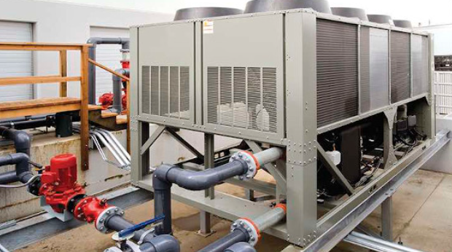

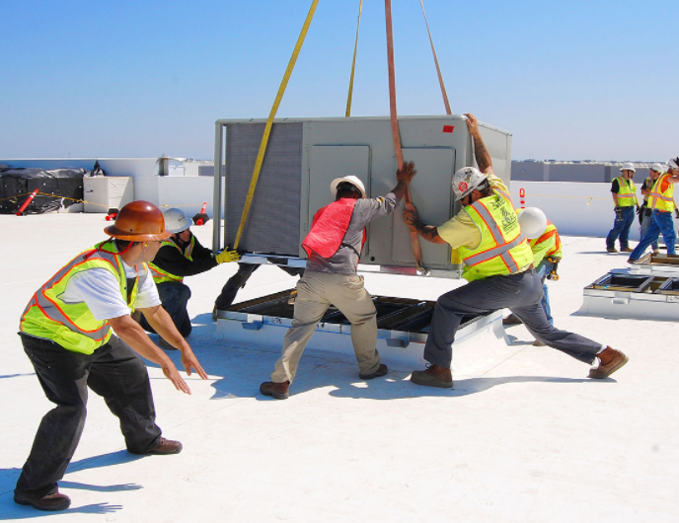
3
OUR SERVICES
AIR-CONDITIONING PROJECTS
Chiller Plant Installation
AHU Installation
Buildings Air Conditioning Projects
Housing Air Conditioning Projects
Constructing Turn Key Projects
Comprehensive Constructions
Fire Alarm & Safety Installations
Plumbing & Electrical Works
CCTV Complete Supply & Installation
Network Data Cabling

Slide 7
3
Our Services (Cont.)
PROJECT PLANNING AND DESIGNING
New Project Planning
Project Consultancy
Planning Renovations
Site Visits & Preparations
Civil
Mechanical
Electrical
Control and Instrumentation
Telecom and Security Systems
Co-ordination
Rivet Drawings
As Built Drawings

Slide 8
3
Our Services (Cont.)
FACILITY DEVELOPMENT
Office Setting Up
Gypsum & Glass Partitions
Roof & Ceiling Work
Paint & Polishing Jobs
Floorings • Tiling
Interior Works
Plumbing & Electrical Jobs
Security Cabins

Slide 9
3
Our Services (Cont.)
MAINTENANCE WORKS
Building Maintenance
Process Facility Maintenance
HVAC Jobs
Electro Mechanical Jobs
Metal Fabrications
AMC Contracts
All Kind of Maintenance Jobs

Slide 10
4
Our Clients – Kuwait
MEW | PEPSI | MPW | Gulf Cable & Electrical Co. | Kharafi National
United Foodstuff Industries Group Co. K.S.C.C | ABC Arabian Beverage Co. | Ashraf & Co. Ltd wll | Hassan Abul Marble Factory | Genoa Plastic Industries
Petra Food Manufacturing Company | AL-Sayer Soft Drinks Factory | The Trading & Industrial Equipment Co. wll | Kuwait Pipe Industries & Oil Services Co. | Mediator Industries & Com. Co.
Khazan Conserved FoodStuffs Distributing Co. W.L.L | Food Industries Co. (FICO) | Al Essa Medical & Scientific Equipment Co. wll | Wataniya Fiberglass Plastic Factory | United Neama Group Gen. Trad. & Cont. Co.
Kuwait Industrial Food Co. W.L.L. (KIFCO) | Rawdatain Natural Mineral Water | Gulf Paper Manufacturing Co. K.S.C | Refrigeration Industries | Mohamed Abdulrahman Al-Bahar
KITCO Kuwait Indo Trading Company Ltd. | KDD The Kuwait Danish Dairy Company | NCCI AL-Watania Paper Products Co. | Al-Rawad Aluminium Factory | Kuwait Boxes
Mickey Snax / Light Food Company (KSCC) | AL-Arabi Plastic Factory | Carton Industries Co. (K.S.C.) | Mondiyal Aluminium Factory | Jerawi Industires
Kuwait Food CO. | AL-Adasani Est. | Kuwait Catalyst Company | Al-Misbah Al-Kuwaitia for Aluminium Co. | Sour Fuel Marketing
Kout Food Group | Al-Nawras Plastic Bag Co. W.L.L. | GTC Paint Company Ltd. | Kuwait Protein & Fat Production Co. | ZAIN
Al-Seedawi Sweets Factories Co. KSC | Wataniya Fiber Glass (Reinforced Plastic Factory Co.) | International Powder Coating Co. | Kuwait Building Manufacturing Co. | Khalid Pastic Industries
Shorouq Pack Flexible Packaging | Plastic Industries Company | Hygiene Products Industries | Kuwait International Garment Factory | Almeer industries
British Industries (Printing & Packaging Co.) | The Plastic Co. Ltd. | Subhan Manufacturing Co. Shampoo, Detergents | Alam Steel | Kuwait United Poultry Co. (Salmi)
Kuwait Packing Materials Manufacturing Co. (KSC) | PEPSI | Sabriya International Gen. Trd. Cont. Co | Gulf Cable & Electrical Industries Co.(G.C) | Mena Steel
Plastic Pipes & Fitting Factory | ABC Arabian Beverage Co. | Gulf Paper Manufacturing Co. K.S.C | Hassan Abul Marble Factory | Genoa Plastic Industries
United Foodstuff Industries Group Co. K.S.C.C | AL-Sayer Soft Drinks Factory | NCCI AL-Watania Paper Products Co. | Kuwait Pipe Industries & Oil Services Co. | Mediator Industries & Com. Co.

Slide 11
4
Our Clients – Kuwait
Carpets Industry Co. (K.S.C.) | National Industries Company | Liebherr PM | Inter Pack | Caesar Pac
AL-Alamiah For Manufacturing Tempered Glass Co. (W.L.L.) | Gulf Insulating Materials MFG Co. | Metex Gen.Trad & Cont Co. | Al Sultan & Khalaf Trading Co. | Gulf Express Glass Est
Rifai Glass Co. | National Textiles | Rasco Co | Kuwait Switchgear Controls Co. | Al-Amalyawm
Gulf Glass Manufacturing Co K.S.C. | KCC Engineering & Contracting Co. | Reliance Technical Est | Sinopec | QP Productions
Kuwait Aluminum Extrusion Co.(K.S.C.C.) | Dakheel Al-Jasaar | Tariq Alghanim | Carrier Kuwait Air Conditioning K.S.C. | 4 Films Printing group Company wll
Kuwait Aluminum & Brass Industries Co | AkzoNobel International | Al-Seedawi Sweets Factories Co. KSC | Al Fajr Al Jadid | Al-Khat Printing Press
National Aluminium Factory | Kuwait Perfumes Factory | Kuwait Americana Food | Mohamed Abdulrahman Al-Bahar & Partners | Bumper to Bumper
Kuwait Portland Cement Co. | Mediator | Fawaz Co. | Safwan | Dasco
Al-Ahleia Switchgear Co. K.S.C.C. | Kuwait Envelops & Folders Factory | M.A. Kharafi & Sons Co. W.L.L. | Al Mulla Air Duct | The National Paper & By Products Co. W.L.L.
Al-Nisf Electrical Co. W.L.L. (Switchgear Plant) | Al-Alwar Printig Press Co. | ROC | Al Rai News paper | Technical Glass Factory
Ahmad Hassan Boland | Al-Alfain Printing. Pub. & Dist. Co. k.s.c.c. | Hayat Marble Co. | Gulf Engineering Company k.s.c.c | Al Raya Wood Works
Food Industries Co. (FICO) | Al-Bahar Industries W.L.L. | Abraaj | Movenpick | Caesar Pac
Carpets Industry Co. (K.S.C.) | National Industries Company | Liebherr PM | Inter Pack | Gulf Express Glass Est
AL-Alamiah For Manufacturing Tempered Glass Co. (W.L.L.) | Gulf Insulating Materials MFG Co. | Metex Gen.Trad & Cont Co. | Al Sultan & Khalaf Trading Co. | Al-Amalyawm
Rifai Glass Co. | National Textiles | Rasco Co | Kuwait Switchgear Controls Co. | QP Productions

Slide 12
4
Our Clients – Kuwait
Al Humaizi Printing Press | Al-Tafooq International Co. | Al-Bahar National Company | KCPC | Al-Watani Fiberglass Co.
Kana Controls Gen.Trad. & Cont. Co.wll | Saipem | Al-Mulla Group | Industrial Consturction & Trading Co. (ICTCO) | Kharafi National Calibration Laboratory
SB Company wll | Darwaza Printing Press | Kuwait Development & Trading Company | Hot Engineering & Factory (Construction) Co. | National Petroluem Services K.S.C.C
Al-Othman International for Air Conditioning | Golden Warah Gen. Trading & Cont. Co. | Tareq Co. wll | Integrated | Gulf Cryo
Mushrif | Al-Essa | Doosan Heavy Industries & Construction | HOV General Trading & Contracting Co. W.L.L. | Al-Seeb Engineering Co. wll
Franklin | Al-Resala Al-Oula | Kuwait Swedish General Trading & Contracting Co. | IMCO Engineering & Consturction Co. W.L.L. | Hyundai Engineering & Consturction Co. Ltd
Diet Center | Arabian Construction Company wll | Hamad Al Mutawa Trading | Spetco | Kuwait National Lube Oil Mfg. Co.
Seas & Desert Group | Sas Printing Press | Texon | Combaind Group | Gulf Glass Mfg. Co.
Al-Zahem Internatioal Group | Elmec Engineering Company | National Contracting Co. Ltd | Hetco | Foodstuffs Trading Co.
Marafie Engineering Group | Bike Zone Co. | Powerboat Center | Industrial Consturction & Trading Co. (ICTCO) | Alghanim International
Nafisi Electrical Contracting | Al-Mesk Group Co. | Fine Arts Printing Press | Union Construction Materials Manufacturing Co. | GIMCO
Tima Group | Ahmadiah Contracting & Trading Co. K.C.S.C | Big Apple Trading Company | United Paper Industries | IMC
Safwan Trading & Cont. Co. K.S.C.C. | Al-Tafooq International Co. | Al-Bahar National Company | Warba Industrial & Advanced Services Center | Foodstuffs Trading Co.
Al Humaizi Printing Press | Saipem | Al-Mulla Group | Kuwait Steel | MACDONALDS
Kana Controls Gen.Trad. & Cont. Co.wll | Darwaza Printing Press | Kuwait Development & Trading Company | Kuwait International Plastic Co.(Al Masqura Plastic) | AL KOUT FOOD STUFF

Slide 13

THANK YOU

